Slide 1

heart disease Prediction using Patient Data
Team Members:
Ashliya M Riyaz
Arya Mohan G
Aiswarya S

Slide 2
PROJECT OVERVIEW
Heart disease is a leading cause of death worldwide
Early detection can save lives
Machine Learning helps in accurate prediction
Goal: Build a predictive and decision-support system

Slide 3
OBJECTIVES
Analyze patient health data
Identify key risk factors
Predict presence of heart disease
Develop an interactive dashboard for user

Slide 4
DATASET DESCRIPTION
Cleveland Heart Disease Dataset
Total records: 297
Number of features: 13
Target Variable:
0 → No disease
1 → Disease present

Slide 5
KEY FEATURES
Age & Gender
Chest Pain Type
Blood Pressure
Cholesterol Level
Maximum Heart Rate
Exercise Induced Angina
Oldpeak, Slope, CA, Thal

Slide 6
PROBLEM STATEMENT
Predict whether a patient has heart disease
Use clinical data for classification
Improve early diagnosis accuracy

Slide 7
DATA PREPROCESSING
Removed missing and inconsistent values
Data cleaning and formatting
Feature scaling applied
Prepared dataset for modeling

Slide 8
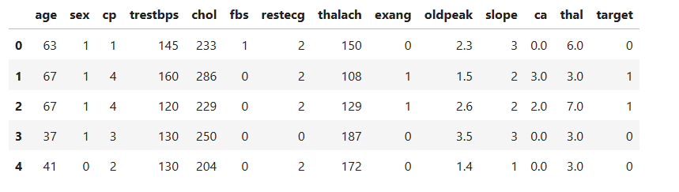
CLEANED DATA

Slide 9
EXPLORATORY DATA ANALYSIS
Studied feature distributions
Identified patterns and trends
Correlation heatmap analysis
Observed relationships between variables

Slide 10
FEATURE SELECTION
Used Mutual Information
Applied Chi-Square Test
Selected most important features
Reduced model complexity

Slide 11
MACHINE LEARNING MODEL
K-Nearest Neighbors (KNN)
Logistic Regression
Gradient Boosting
Compared multiple models

Slide 12
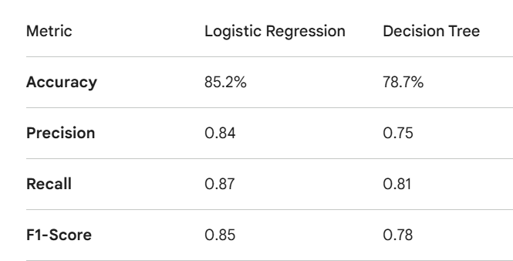
MODEL EVALUATION
Accuracy
Precision
Recall
F1-Score

Slide 13
RESULTS
Logistic Regression performed best
Balanced accuracy and interpretability
Selected as final model

Slide 14
MODEL DEPLOYMENT
Model saved and integrated
Built using Streamlit
User-friendly interface
Real-time predictions

Slide 15
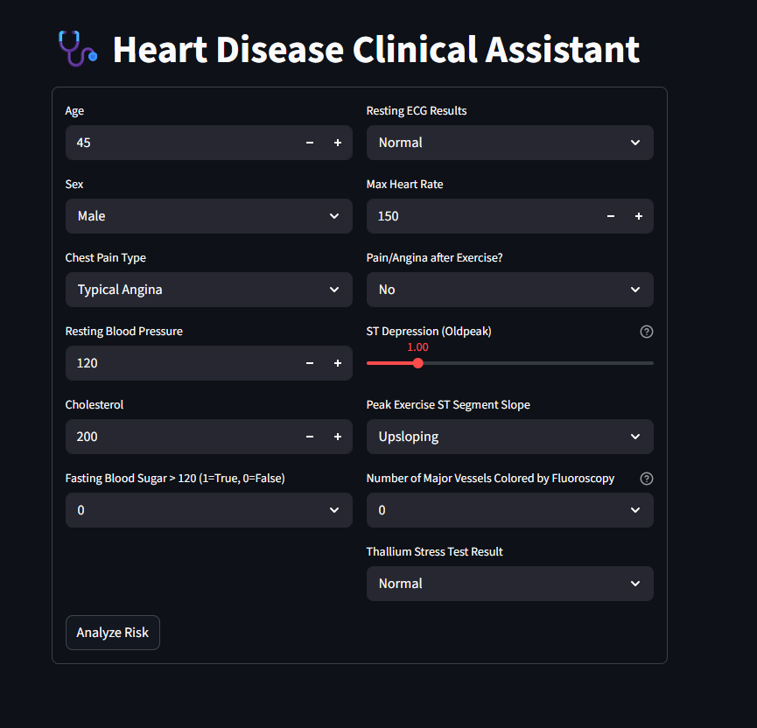
APP INTERFACE

Slide 16
WORKFLOW
Data Collection → Data Cleaning → Preprocessing → EDA →
Feature Selection → Model Training → Model Evaluation →
Model Selection → Model Saving → Deployment → Prediction

Slide 17
CONCLUSION
Machine Learning can aid early diagnosis
Logistic Regression gave reliable results
System helps in clinical decision support
Can be extended with more data

Slide 18
FUTURE SCOPE
Use larger datasets
Improve accuracy with deep learning
Integrate with hospital systems
Add real-time patient monitorin

Slide 19
LIVE APPLICATION
Streamlit web application available
Predict heart disease instantly
Easy to use interface

Slide 20
THANKYOU….

